Slide 1
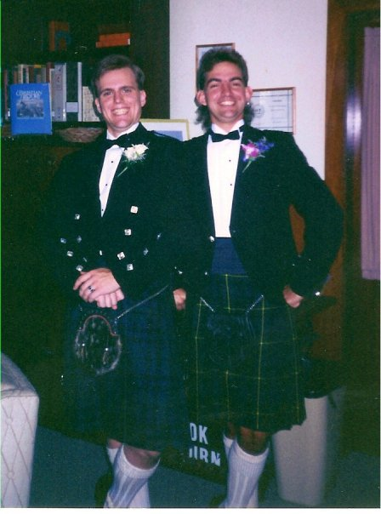
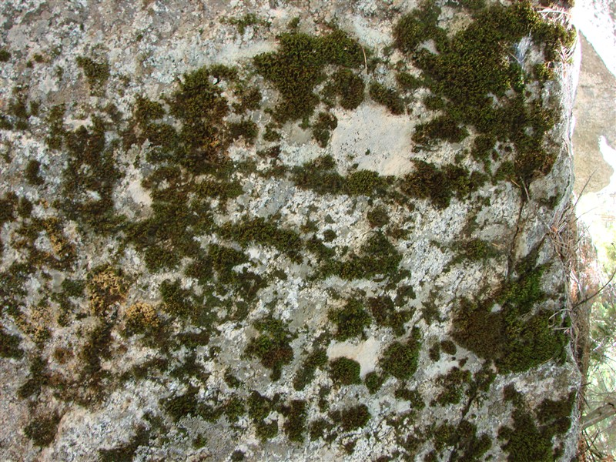
Scotch on the Rocks
Keith Evan Schubert
Penny Boston, Jane Curnutt, Ernesto Gomez

Slide 2
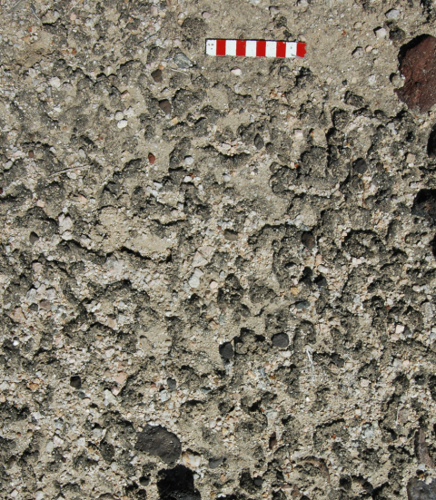
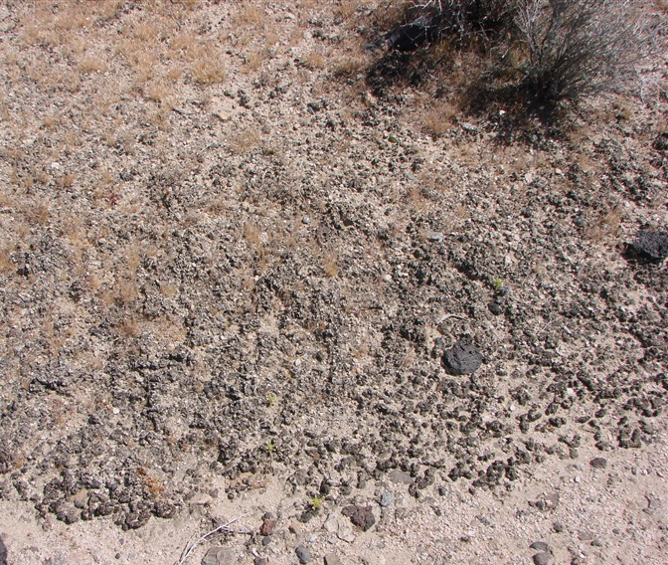
Biological Soil Crusts

Slide 3
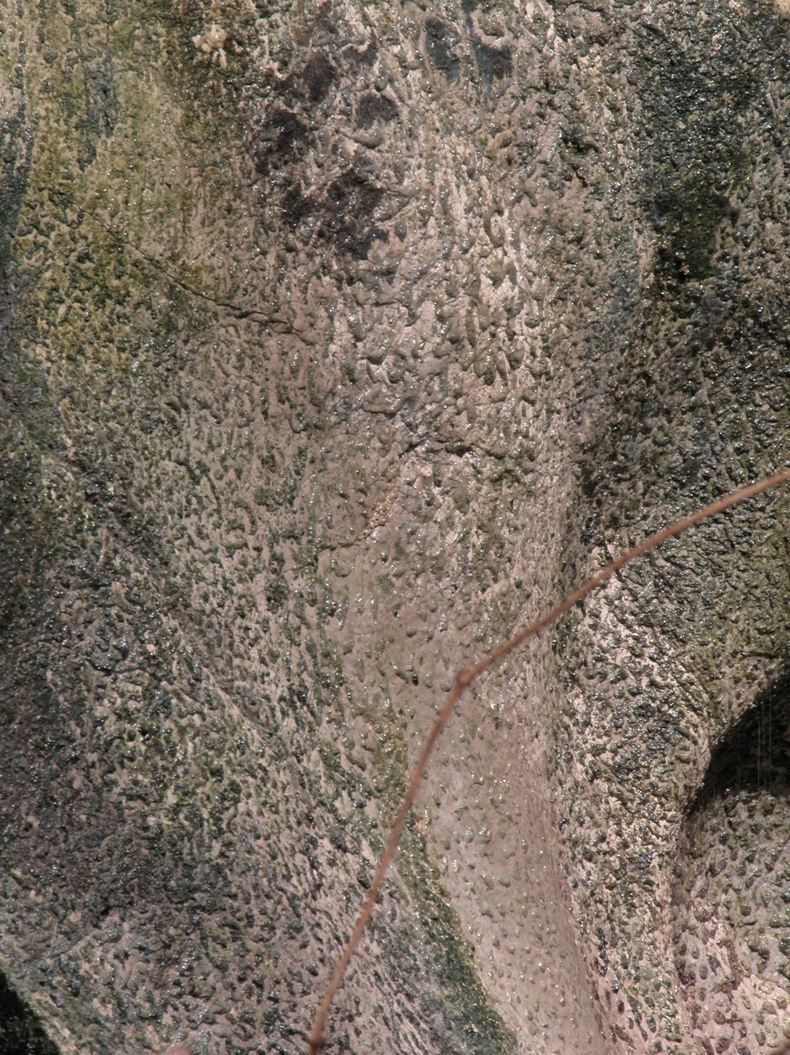
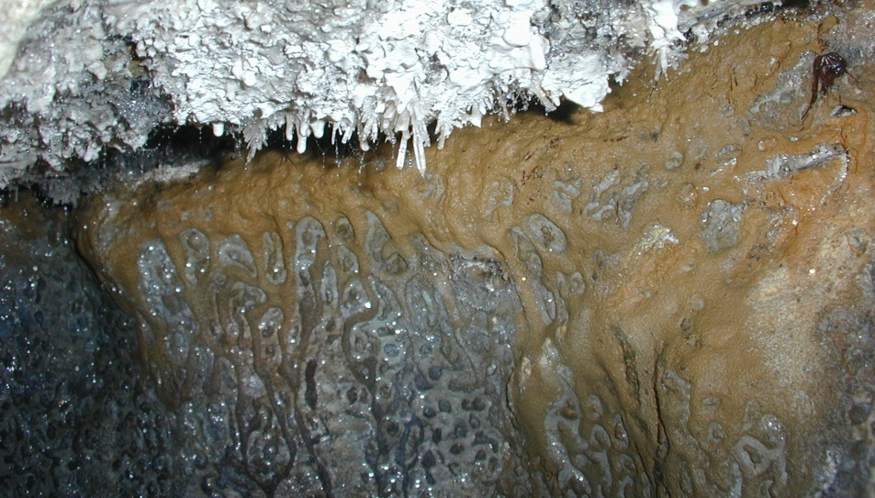
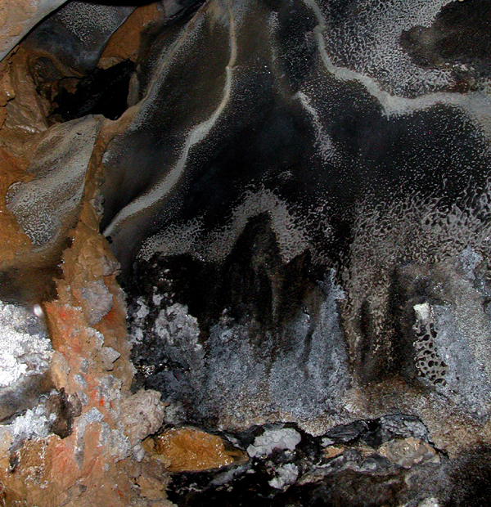
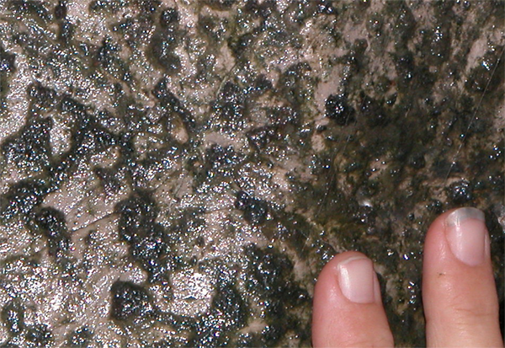
Solid lawns of goo grade into biovermiculations and back again
In the twilight zone,
organisms are photosynthetic….
Images by K. Ingham
Image by P. Boston

Slide 4
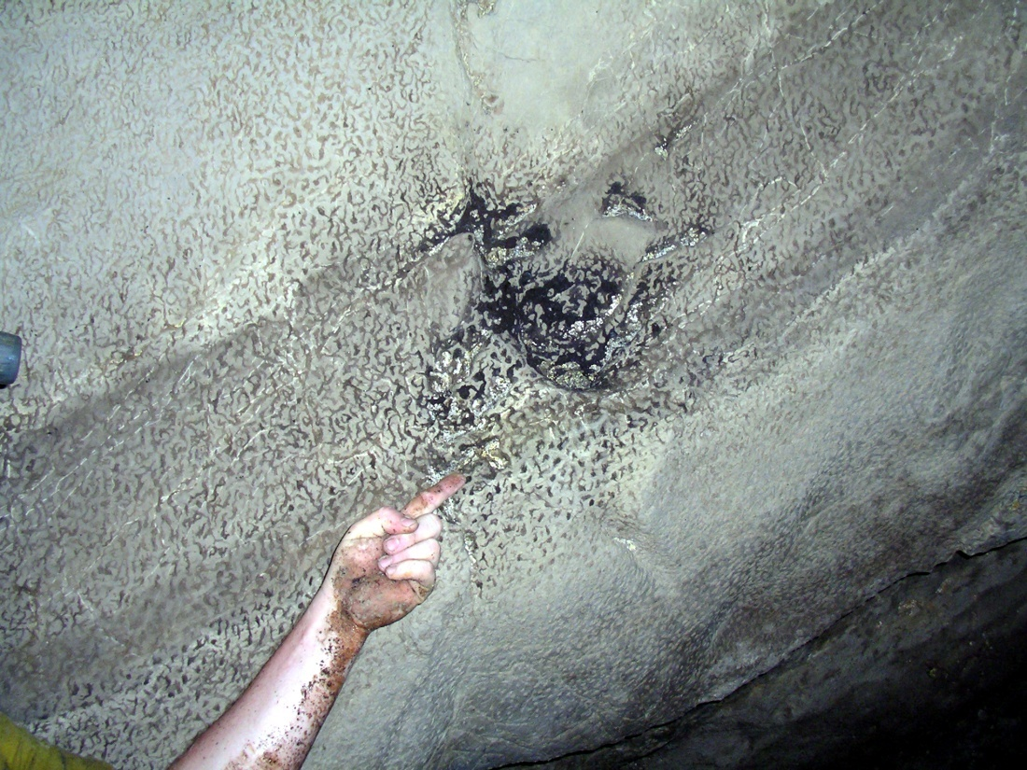
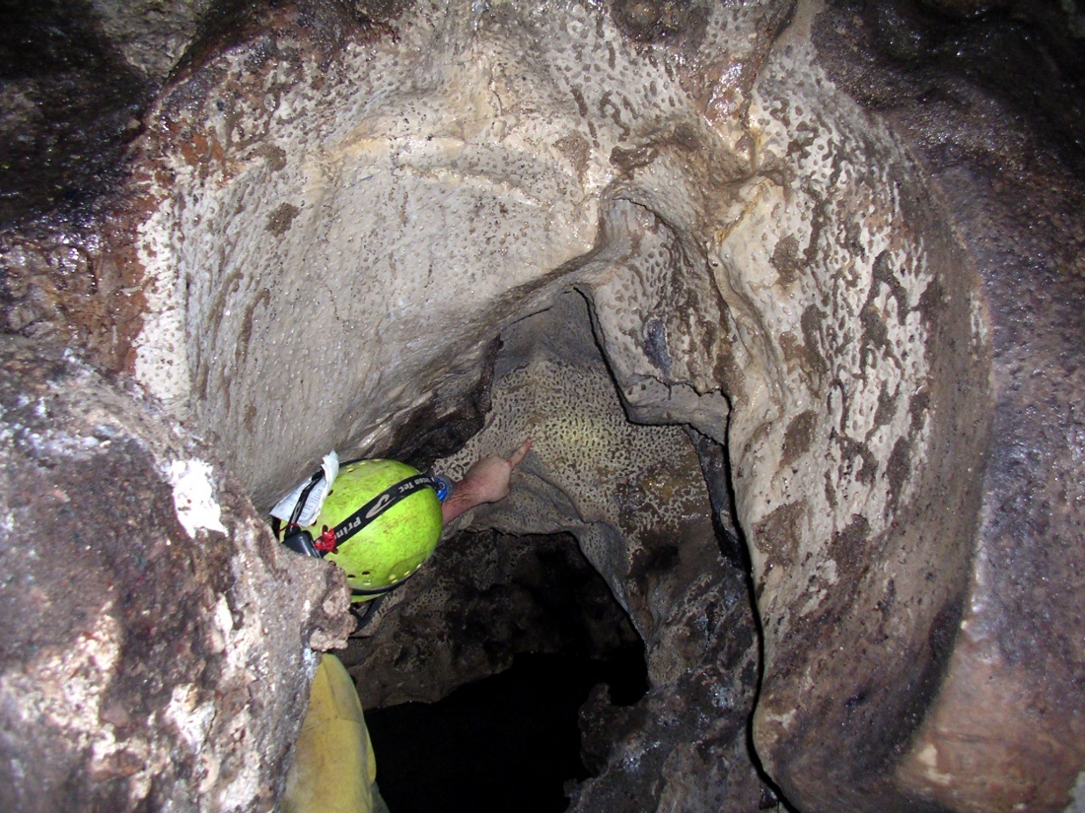
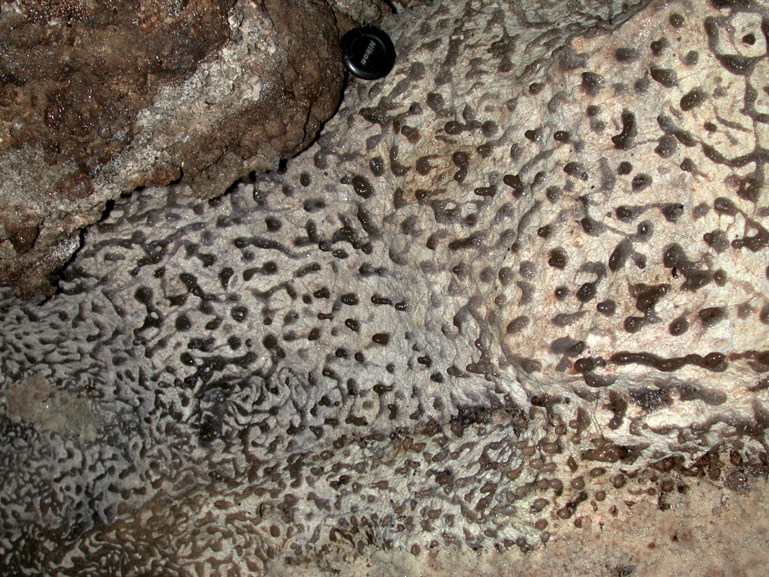
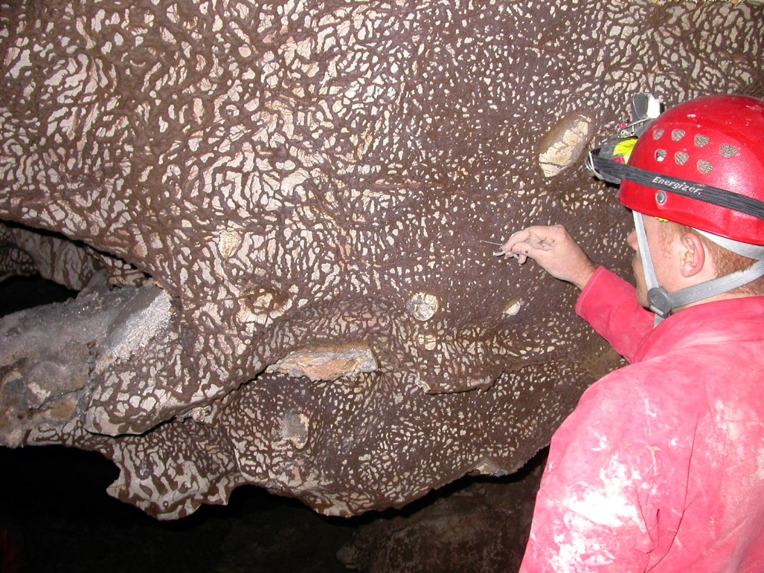
Sulfur caves….
Luna Azufre, near Villa Luz
La Joya Cave, Tabasco, MX
Frassassi Cave, Italy, a H2S- rich system.
Dan Jones and Jen Macalady, Penn State.

Slide 5
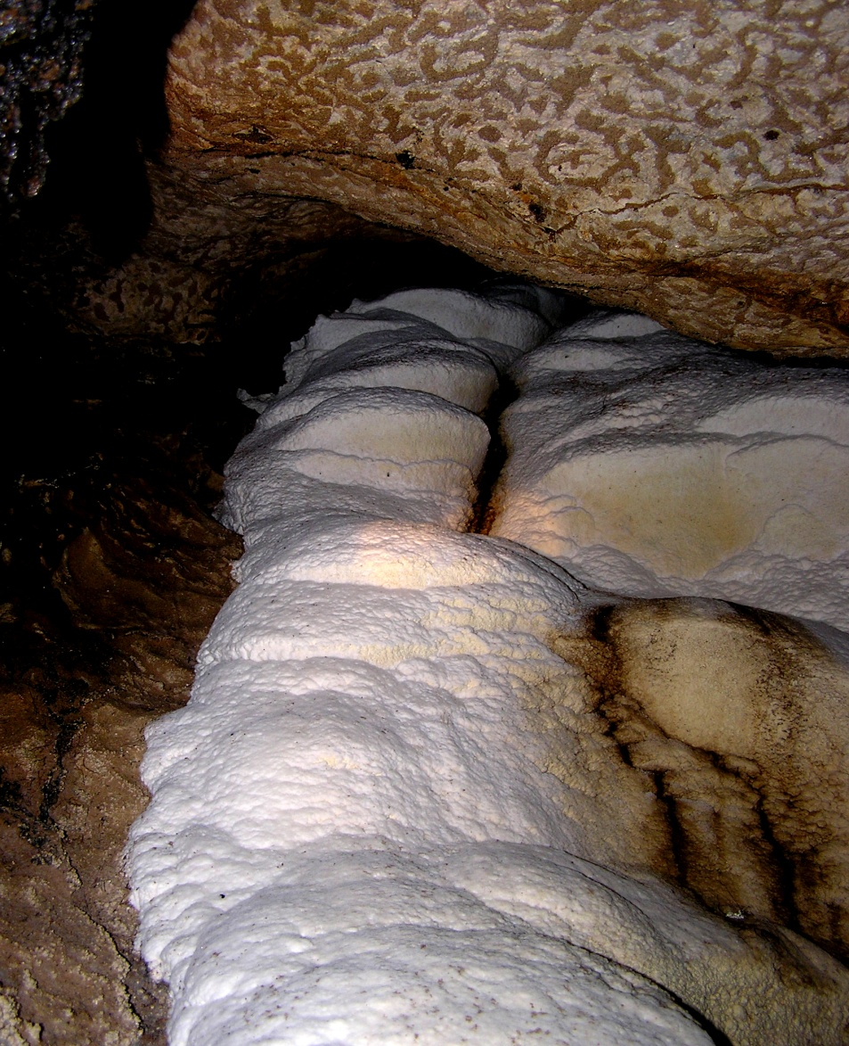
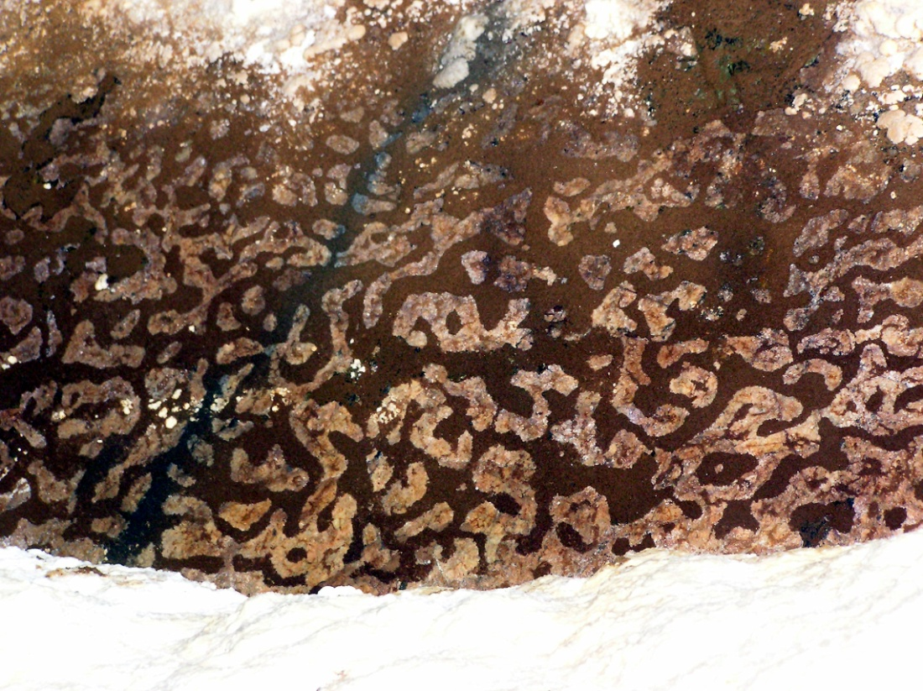
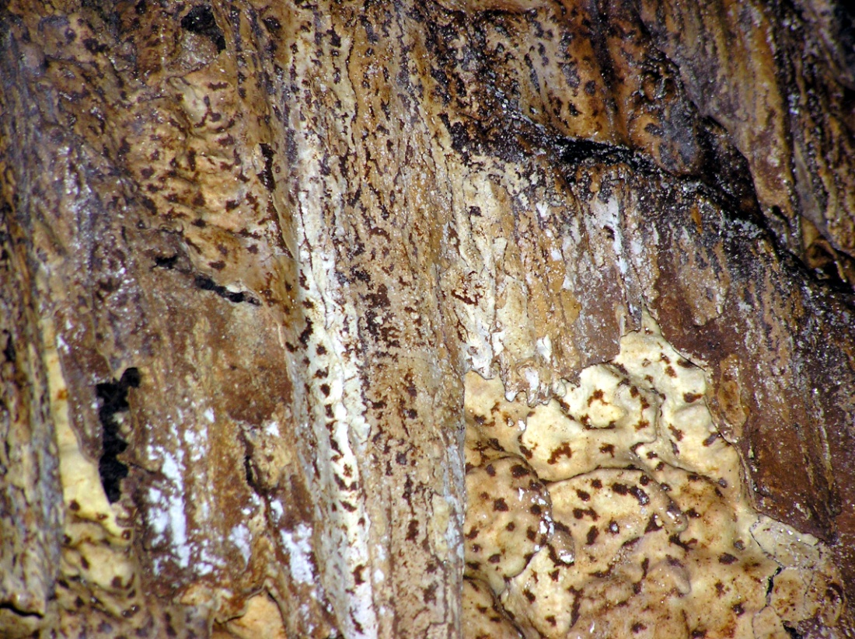
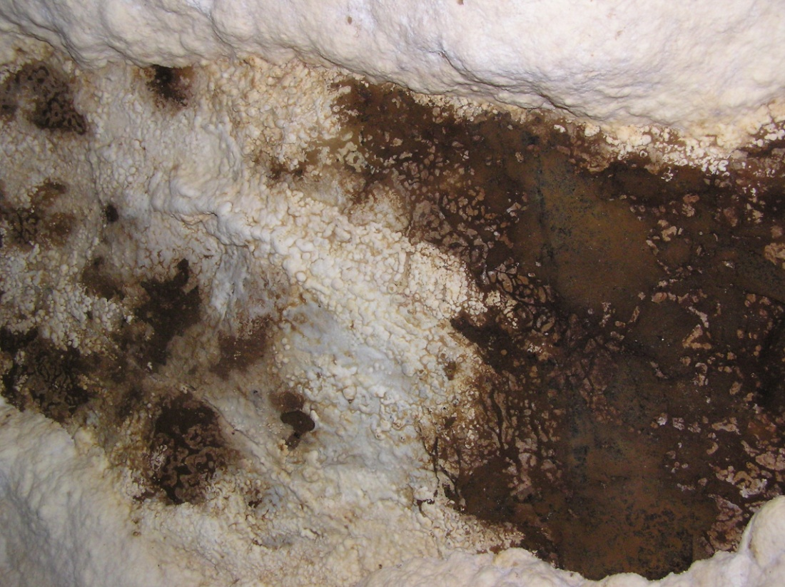
Tongass National Forest, AK
Cataract Cave, above moonmilk
Thrush Cave, above moonmilk
Wingate Cave, heavily iron rich.
A frequently “washed” system…
Bioverms & moonmilk battle for supremacy

Slide 6
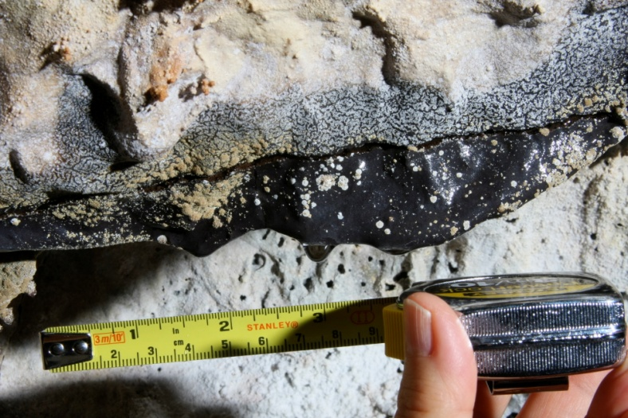
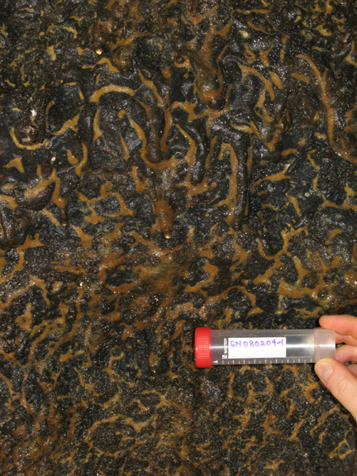
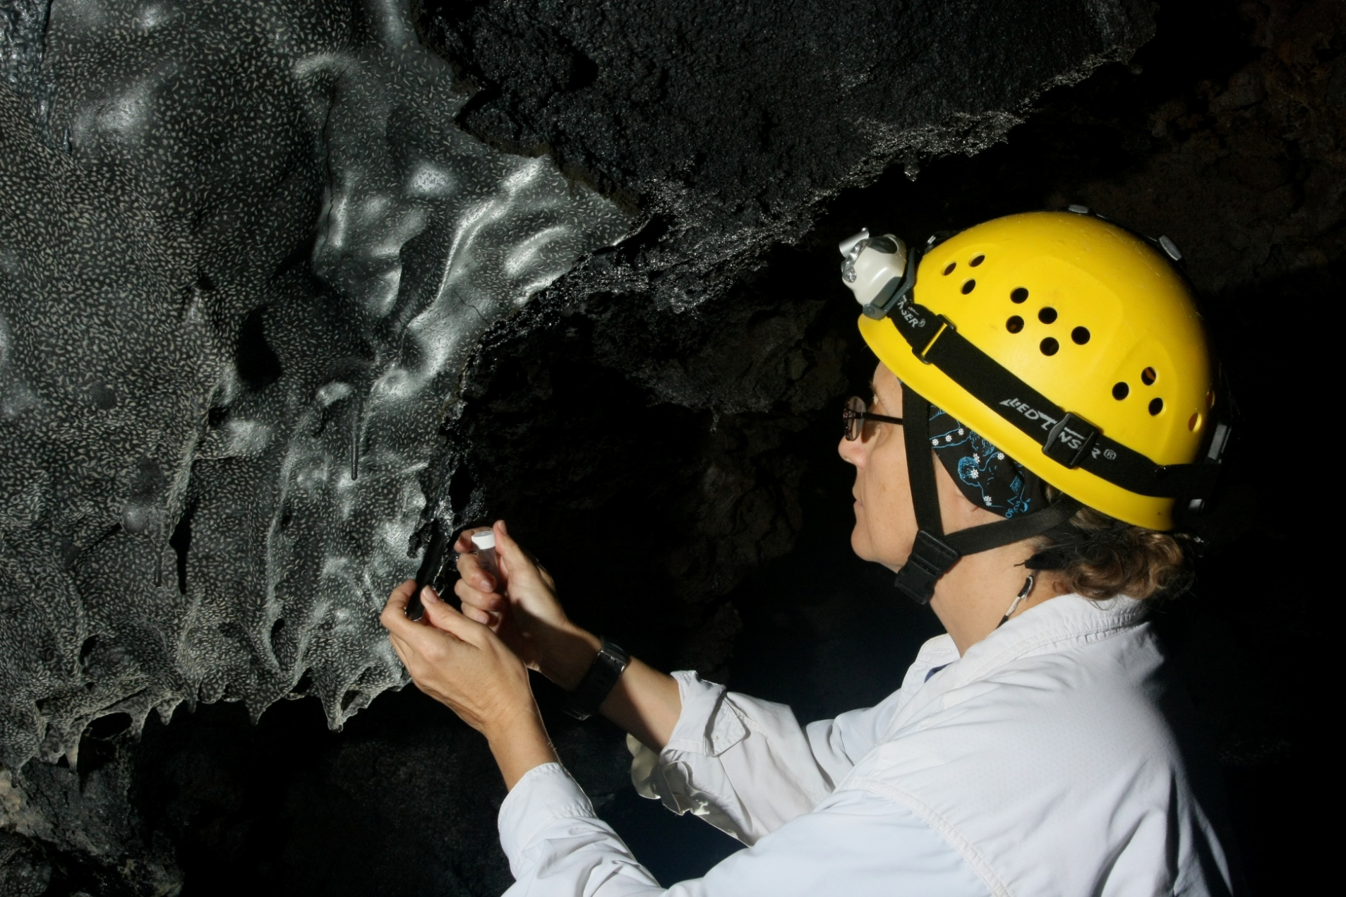
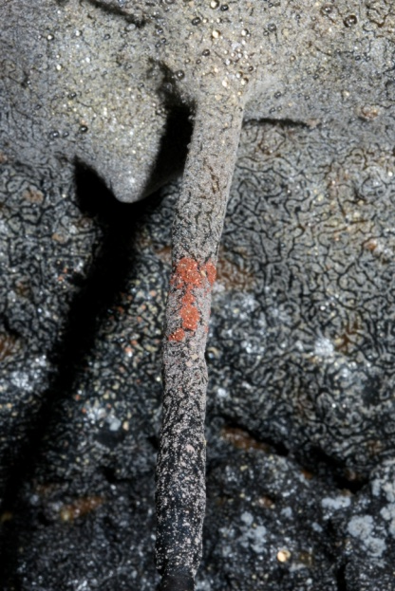
Gruta do Natal, Azores
Lavatube Bioverms
Image by D. Northup
Epperson’s Cave, Hawaii
Kula Kai Cave, Hawaii
Images by K. Ingham

Slide 7
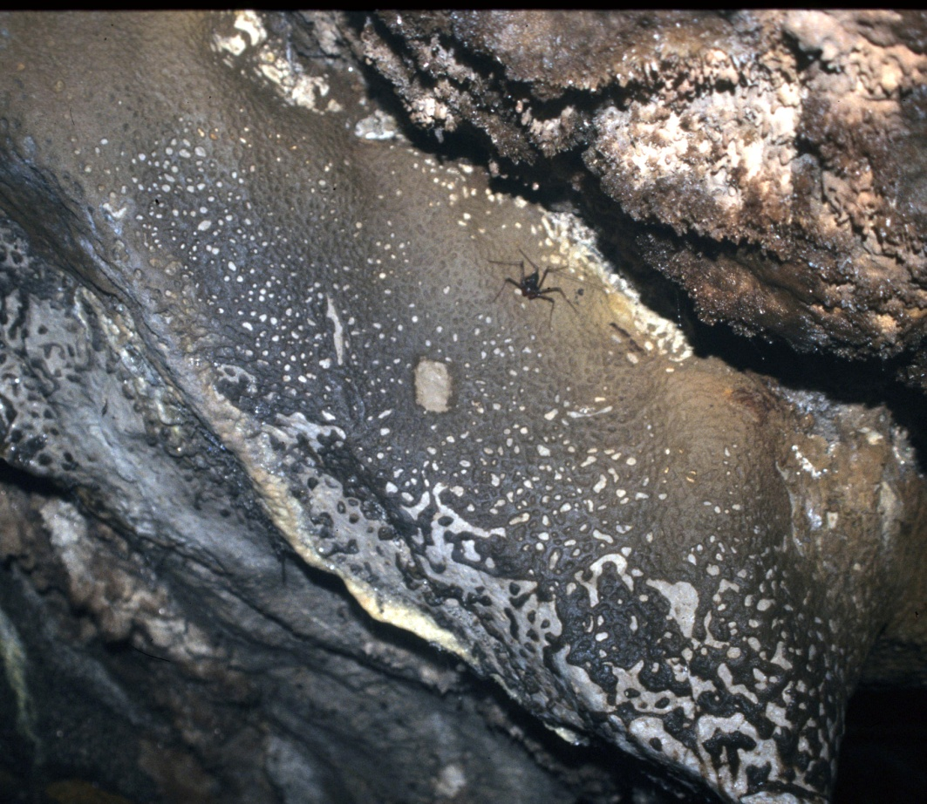
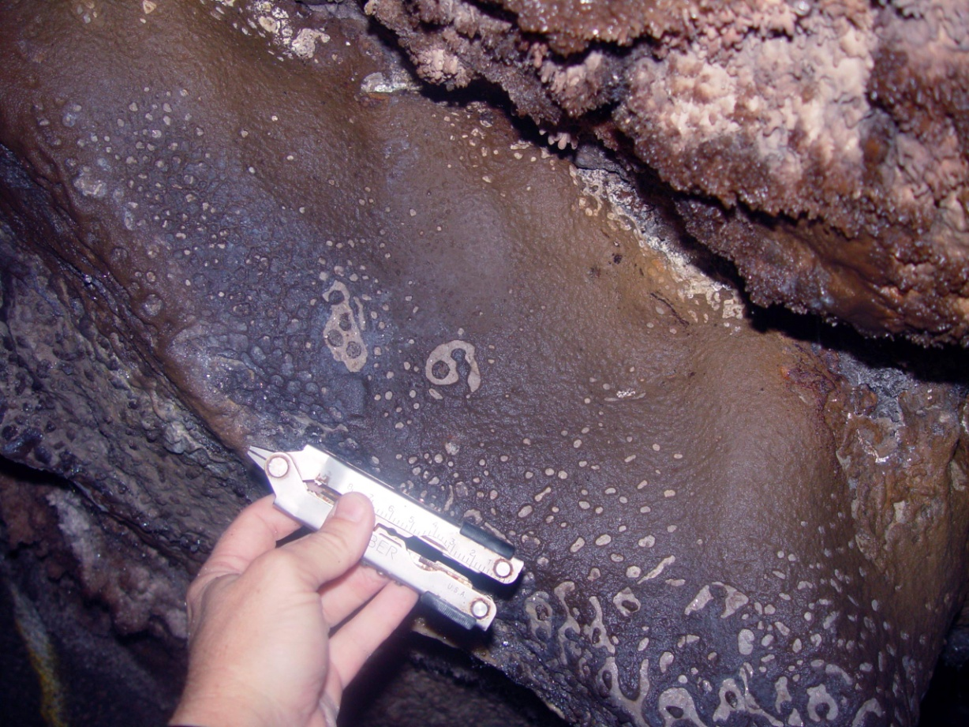
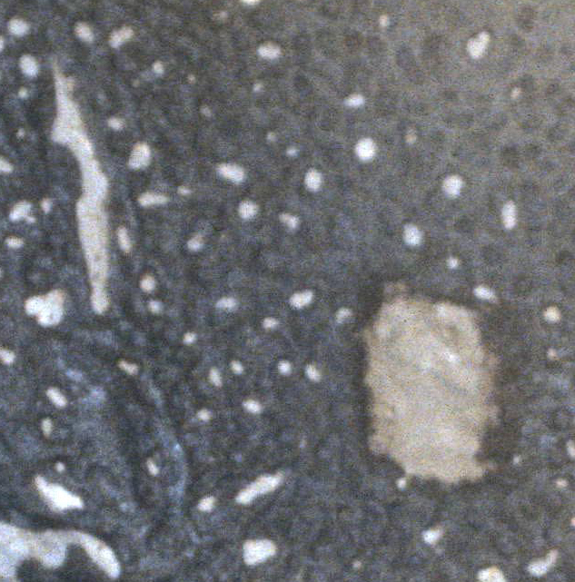
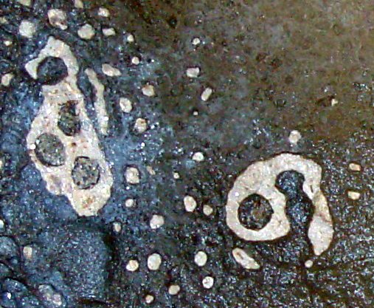
Regrowth experiment by Louise Hose
April 1999
September 2003
TEST SITE 1
Earliest
Most recent

Slide 8
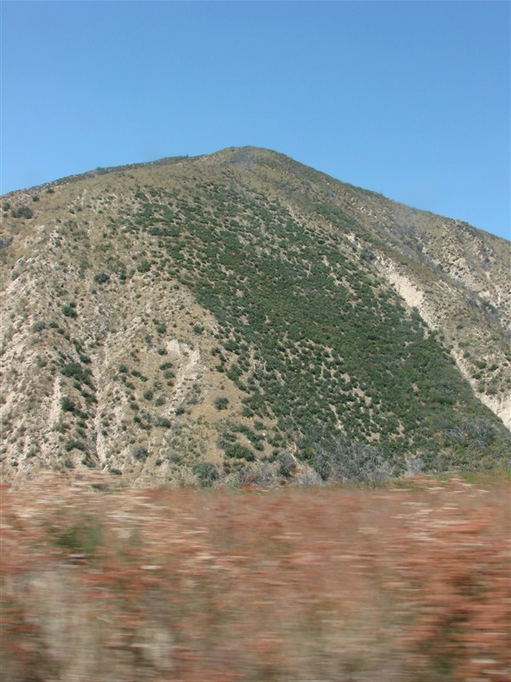
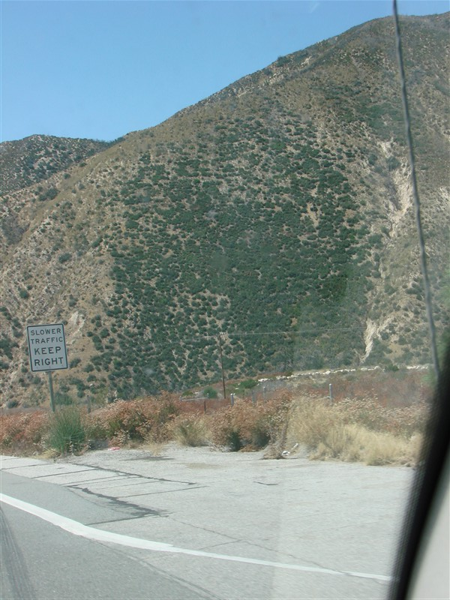

Slide 9
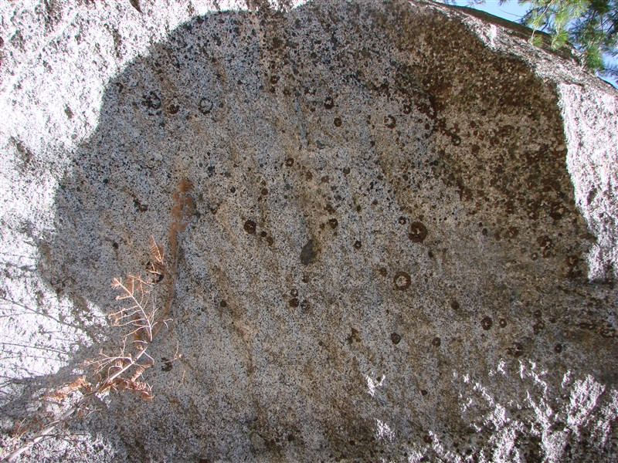
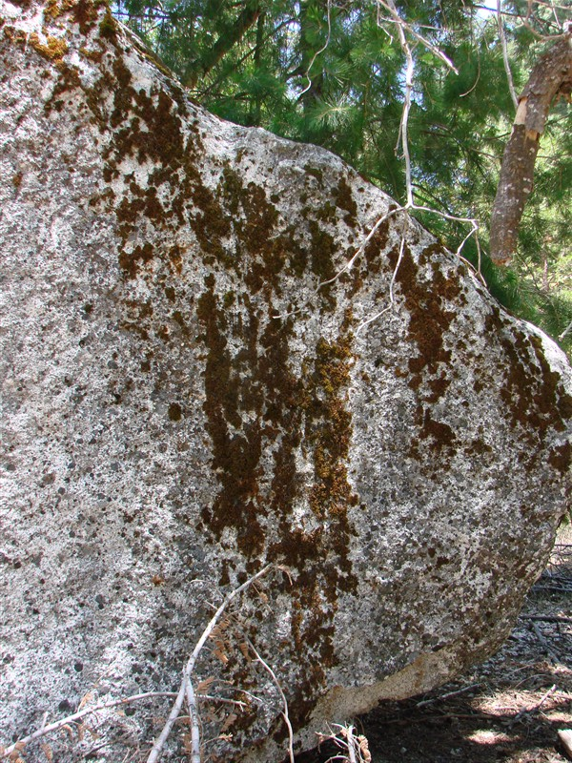

Slide 10
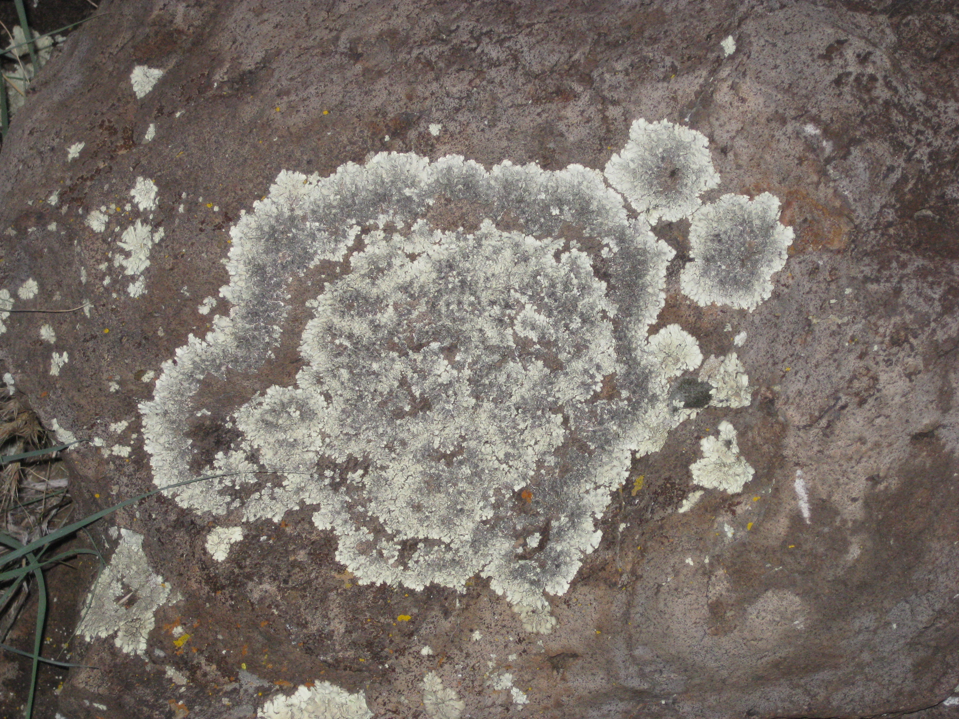

Slide 11
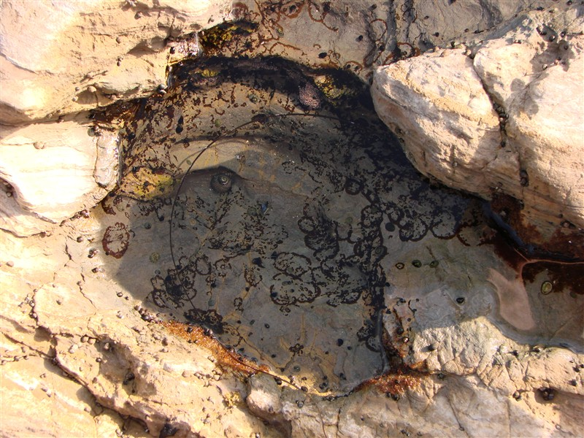
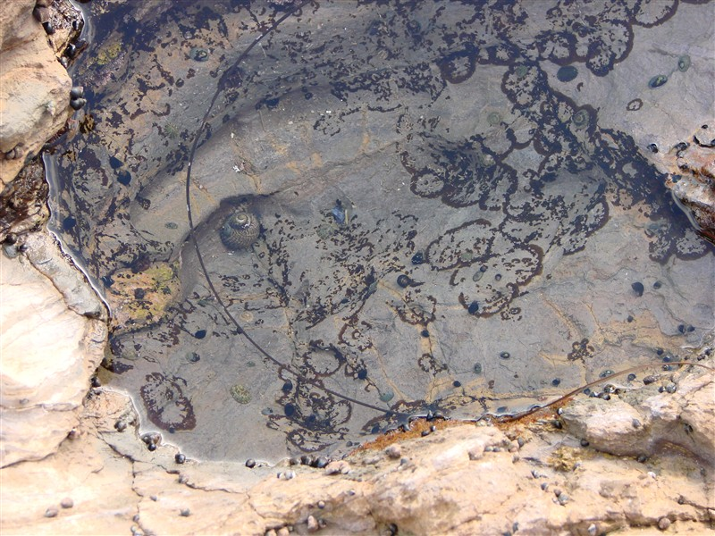

Slide 12
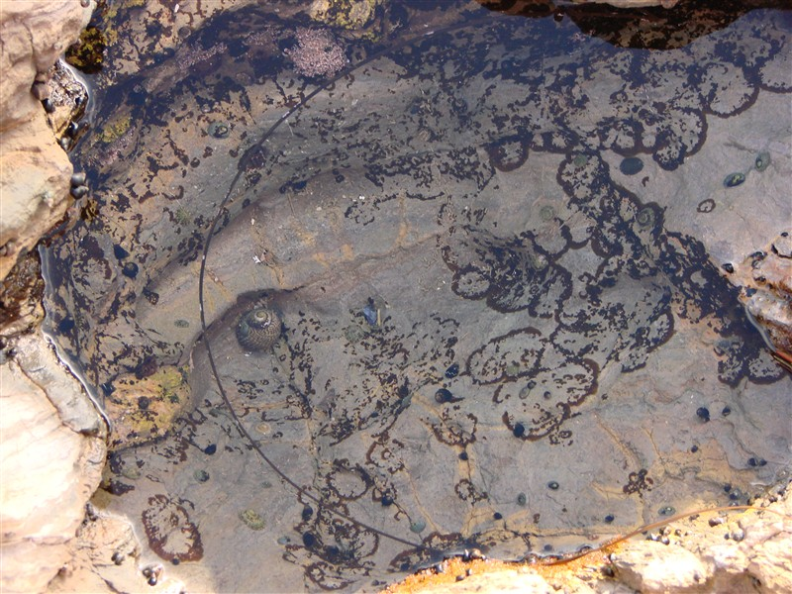
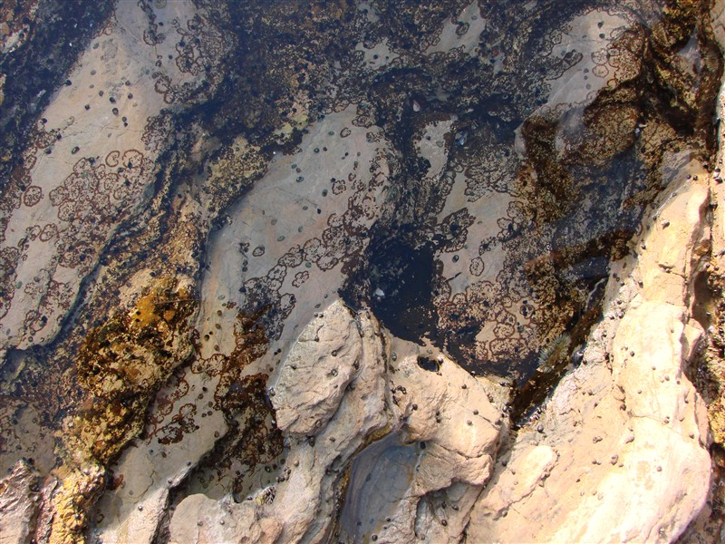

Slide 13
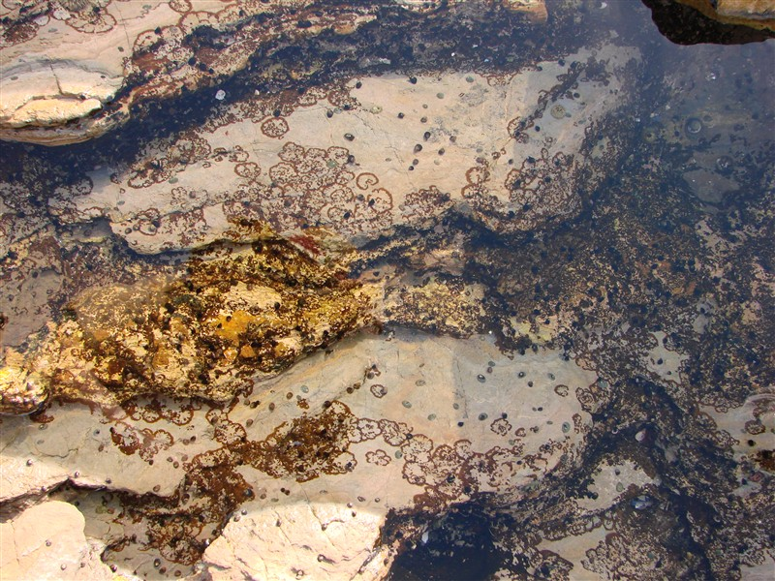

Slide 14
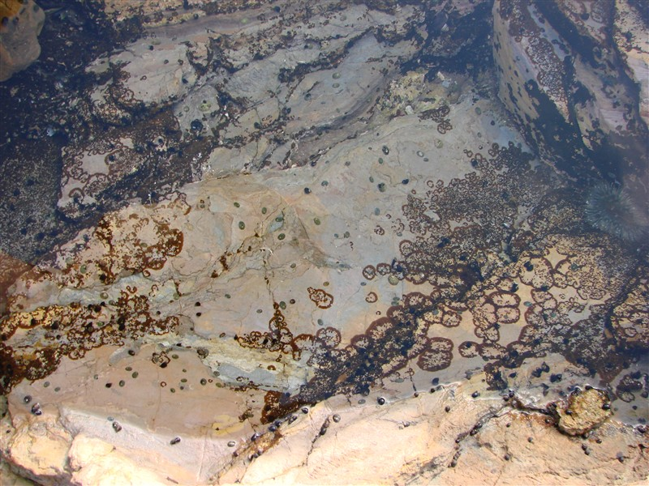

Slide 15
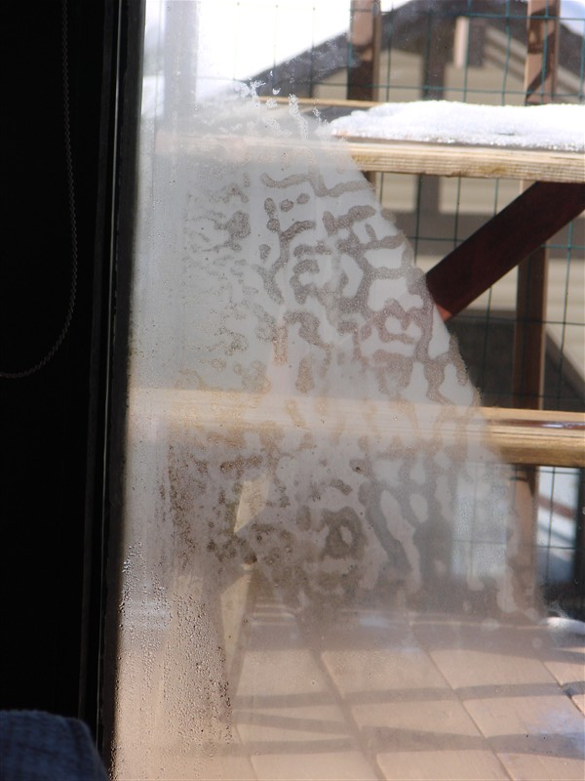
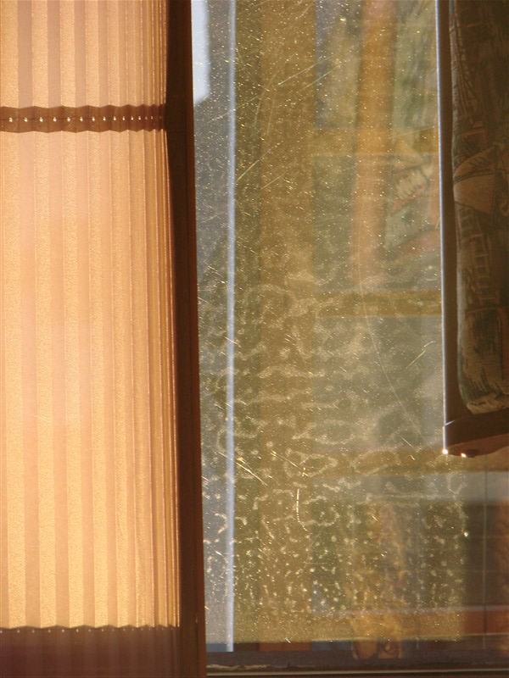

Slide 16
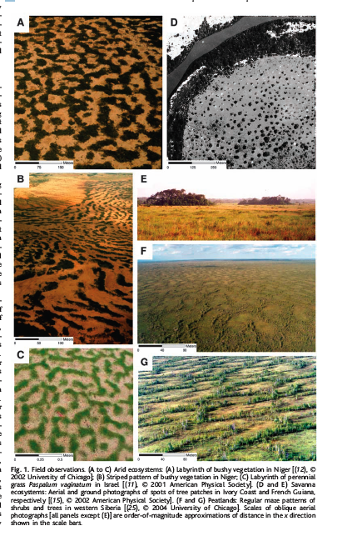
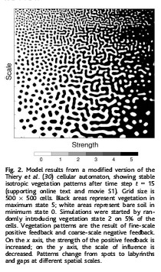
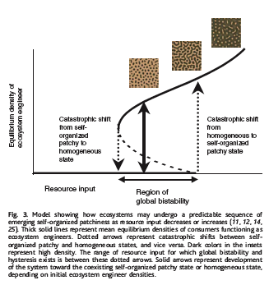
Rietkerk, M., Dekker, S.C., de Ruiter, P.C., & van de Koppel, J. 2004.
Self-organized patchiness and catastrophic shifts in ecosystems. Science 305:1926-1929.

Slide 17
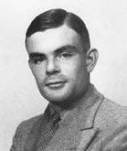

Biological Patterning
U_{t} = DU_{xx}+R(U)
Paper:
The chemical basis of morphogenesis
Image from Greg Turk

Slide 18
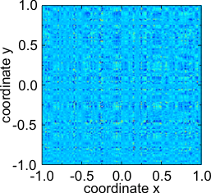
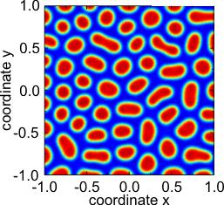
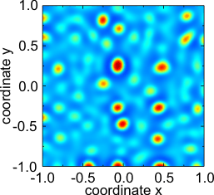
Example
Pictures from Wikipedia

Slide 19
Baseline Model
Growth dependent on water and nutrients
Oscillation and bias
Diffusion
nutrient addition and use
Precipitation
Runoff, evaporation, absorption, diffusion, etc.

Slide 20
Generalized Cellular Automaton
Radius of 3
Each cell has variable for biomass, nutrients, and water
Next state of a cell is based on its current value, those within the radius, random factors
Weights set to capture effect of differential equations

Slide 21
Simple Example
Radius of 3
Each cell has variable for biomass Є {0,1}
Water and nutrients in abundance
Next state of a cell is
same if sum of neighbors in range 8-12
Grow if sum of neighbors in range 13-34
Die else or randomly 5% of time

Slide 22
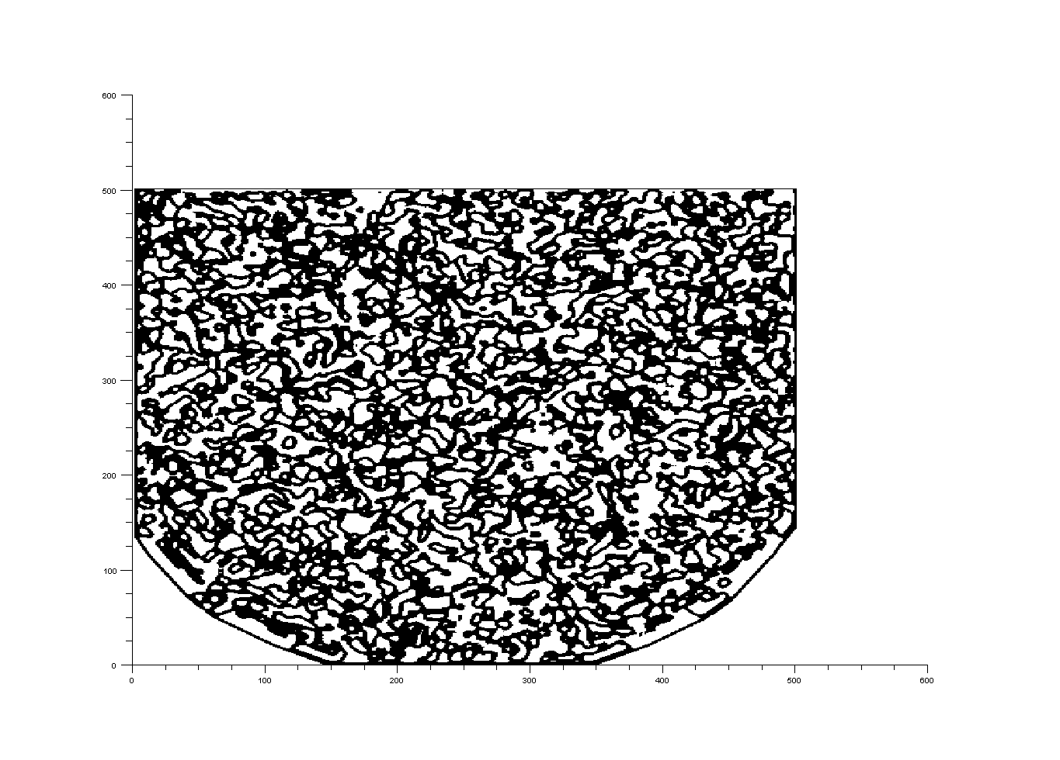
Simulated Bioverms

Slide 23
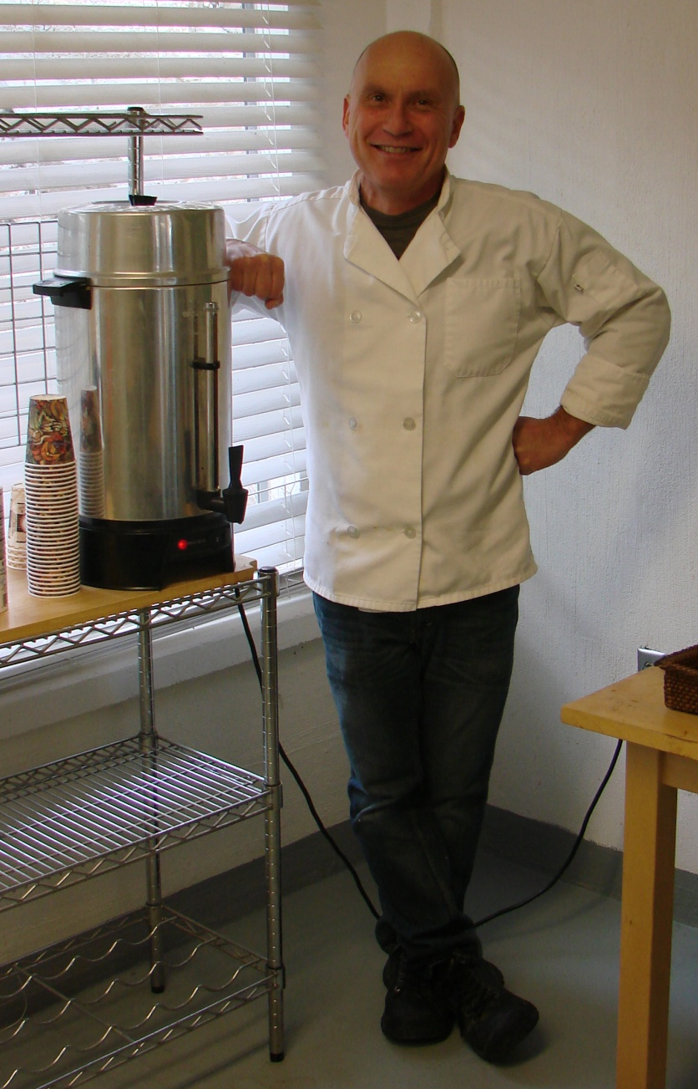
So Long And Thanks For All The Coffee

